Slide 1





Active management of forest protected areas
Mikulov, Czech Republic, 1 – 5 August, 2016
Organizers and sponsors

Slide 2

”My sponsors”
PRIFOR – The Nordic working group on the ecology of primeval boreal forests. A platform for exchange among researchers, students and practitioners and supports the development of a more evidence based forest management and conservation of the forest ecosystems in Northern Europe.
SCB – A scientific society organizing people interested in conservation of biological diversity (scientists, managers, students etc). Its Europe Section aim to promote the vision of SCB in Europe. SCB publish journals, arrange conferences, act on policy issues and providing networking opportunities.
EviEM – The Mistra Council for Evidence-Based Environ-mental Management works for environmental management to be placed on a scientific foundation. Through systematic reviews of various environmental issues, we aim to improve the basis for decisions in Swedish environmental policy.

Slide 3
Our starting point
There is an increasing awareness that simply setting aside forests for free development risks missing out on the conservation of associated biodiversity.
Due to past land use and fragmented landscapes, natural disturbances and process cannot fully operate within single small set-asides.
To support natural values, measures to actively manage forests for biodiversity conservation are being developed.
This meeting will collect researcher and practitioners working in this field for exchanging knowledge and experience through Europe.

Slide 4
Active management of forest protected areas
Some starting points as introduction
Bengt Gunnar Jonsson
Dept of Natural Sciences
Mid Sweden University
Sundsvall, Sweden

Slide 5
Non-intervention, ”Wilderness paradigm”
”Nature knows best”
Setting aside forests for free development
  A management option among many
  In absence of disturbances support development of old-growth characteristics
  Uncontroversial
  Cheap…

Slide 6
Active management
Nature is no longer ”natural”
Interventions for conservation purposes
  Forest protected areas are small and isolated
  Failing to accommodate natural disturbance processes
  Lack of early successional stages
  Forests with high conservation status may sometimes be a product of past low-intensity human use
  With species conservation in focus, forest protected area may be managed for particular habitats and conditions beyond what nature may provide over short time periods (“biodiversity cultivation”)

Slide 7
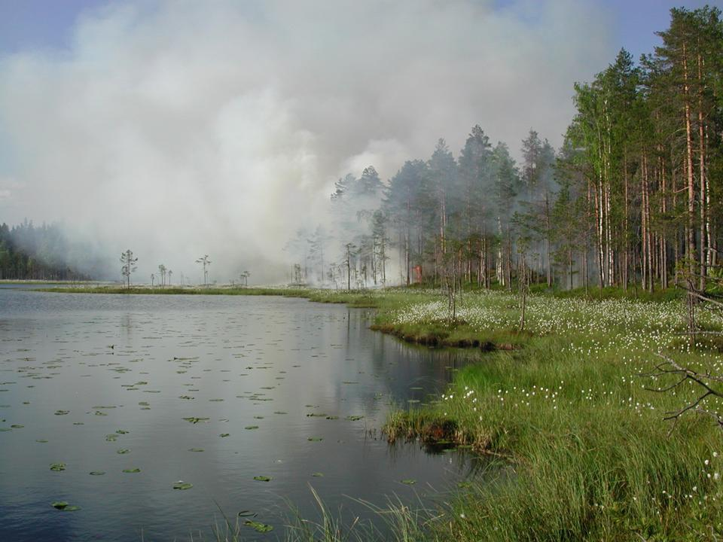
Example – Fire in boreal forests

Slide 8
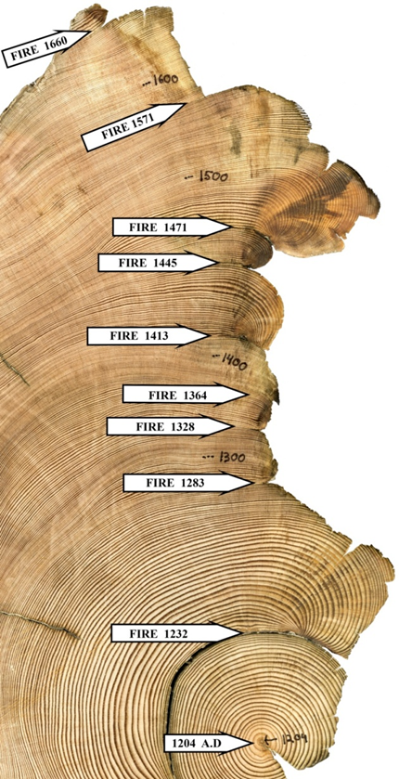
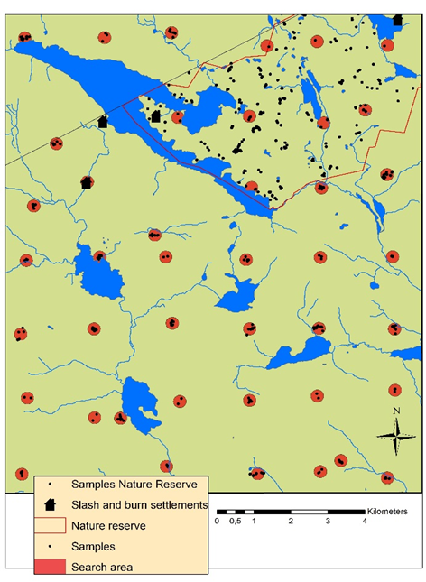
Dendrochronological reconstruction of fire history

Slide 9
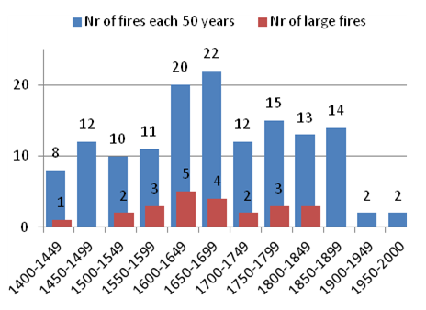
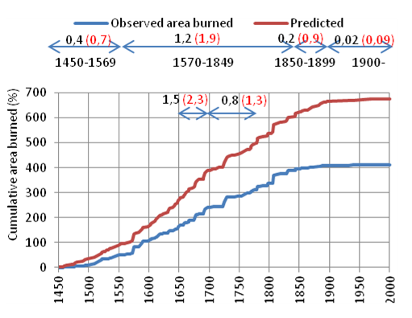
Fire more or less absent during > 100 years

Slide 10
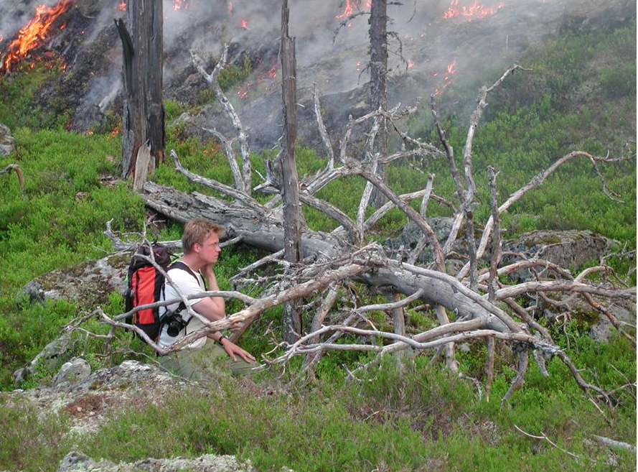

Calls for restoration fire

Slide 11
Other boreal topics suggesting management needs
Large deciduous trees (aspen, goat willow, rowan)
  Declining due to successional progress towards spruce dominance
  Strong browsing pressure from moose and deer
Dead wood
  Currently only 24 m³ha⁻¹ in Swedish protected forests, i.e. about 25% of natural levels
  Dead wood dominated by small diameter conifers and lacking other critical wood qualities

Slide 12
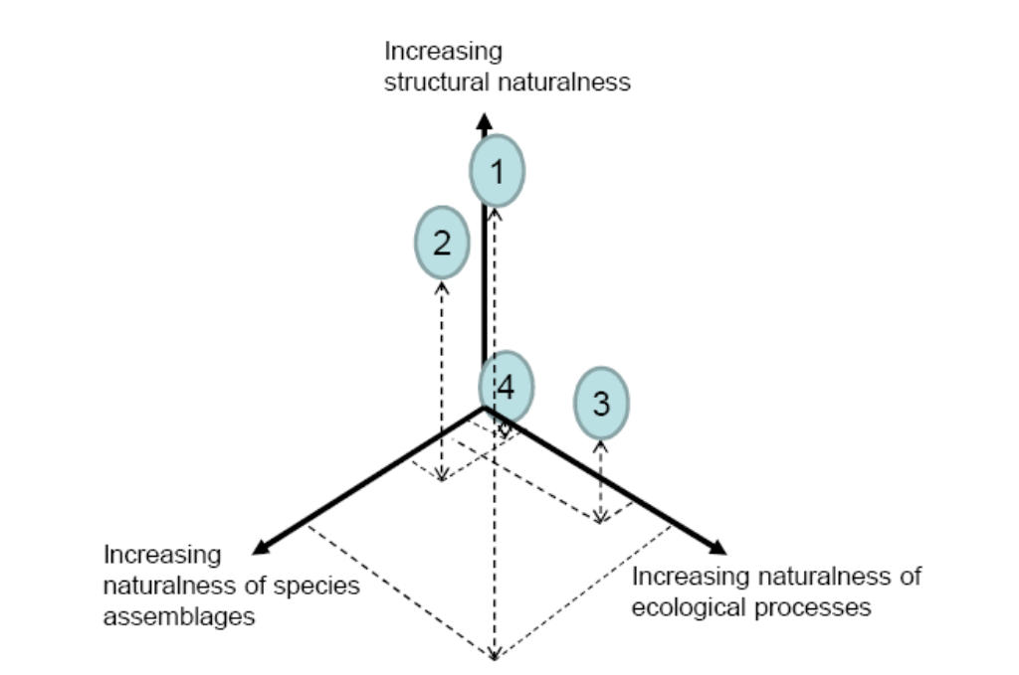
The three axes of naturalness

Slide 13
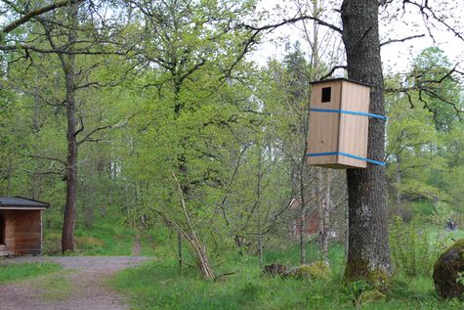
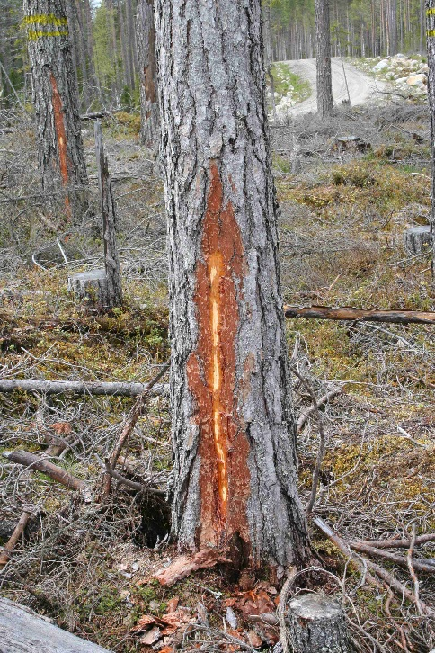
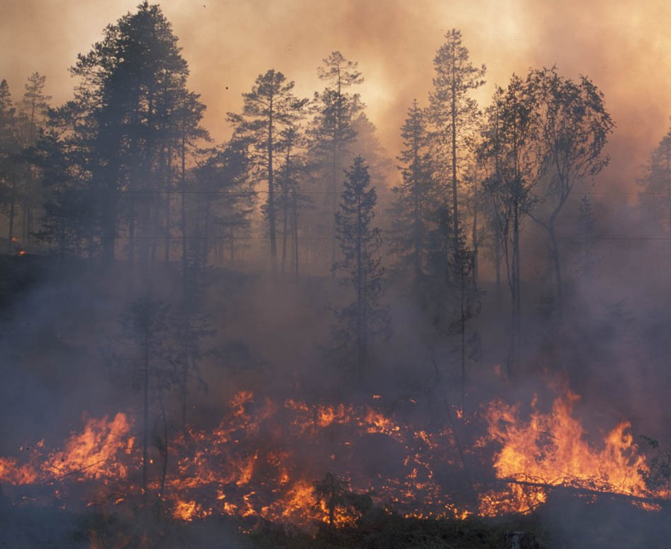
Structures – Species - Processes

Slide 14
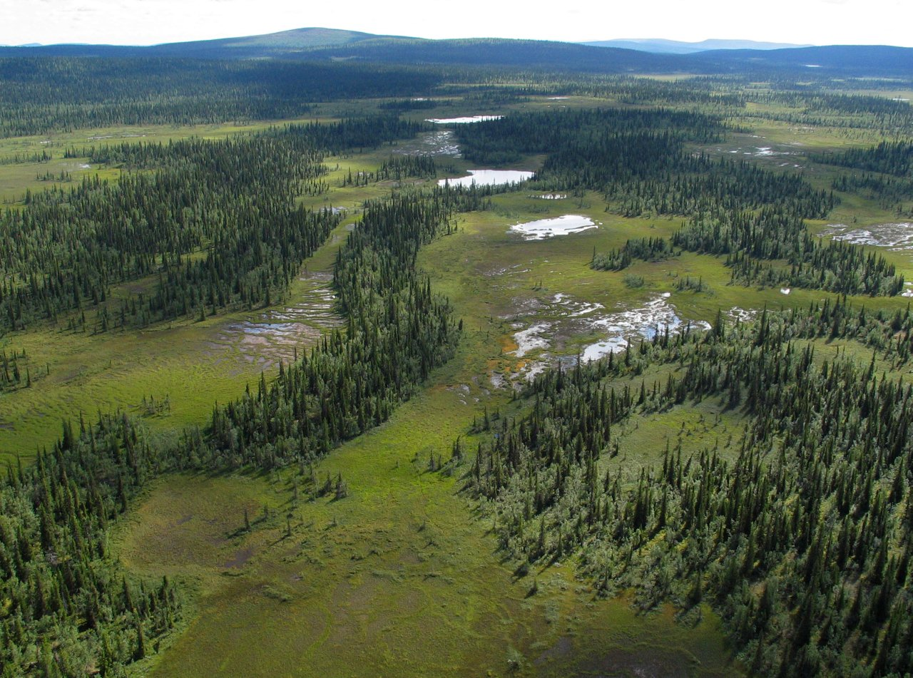
Natural forest landscape still exist, but are becoming very rare

Slide 15
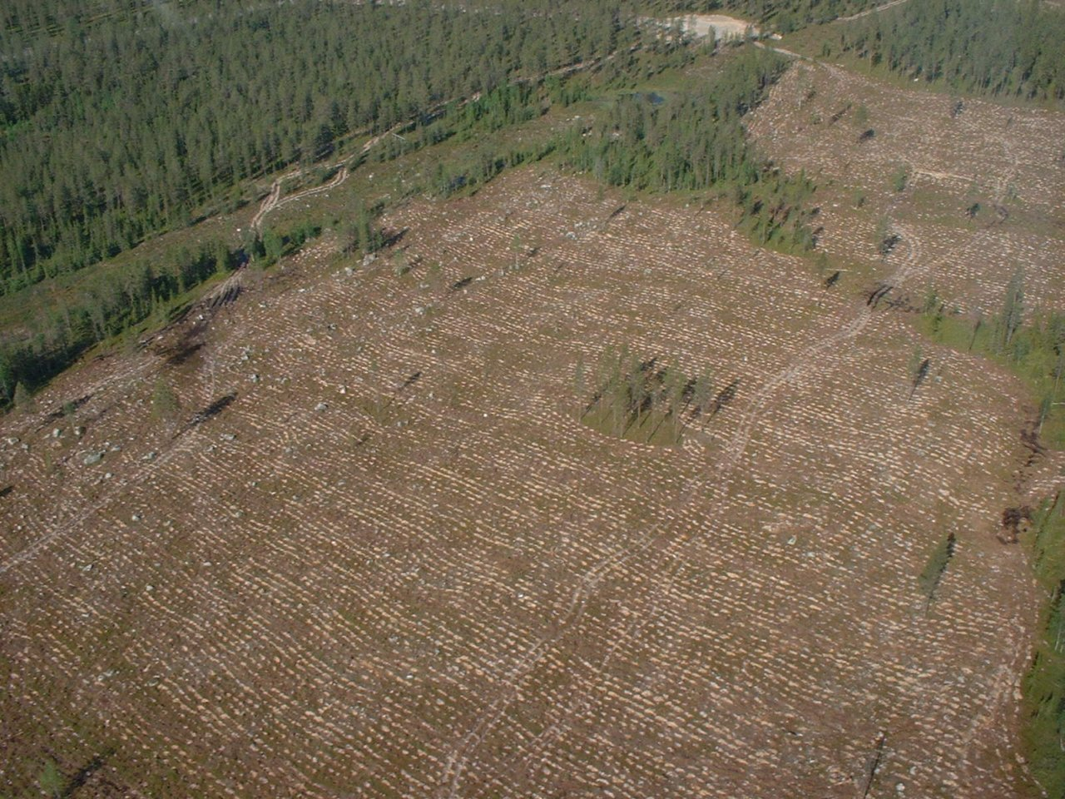
We allow forests to be managed for resource extraction…

Slide 16
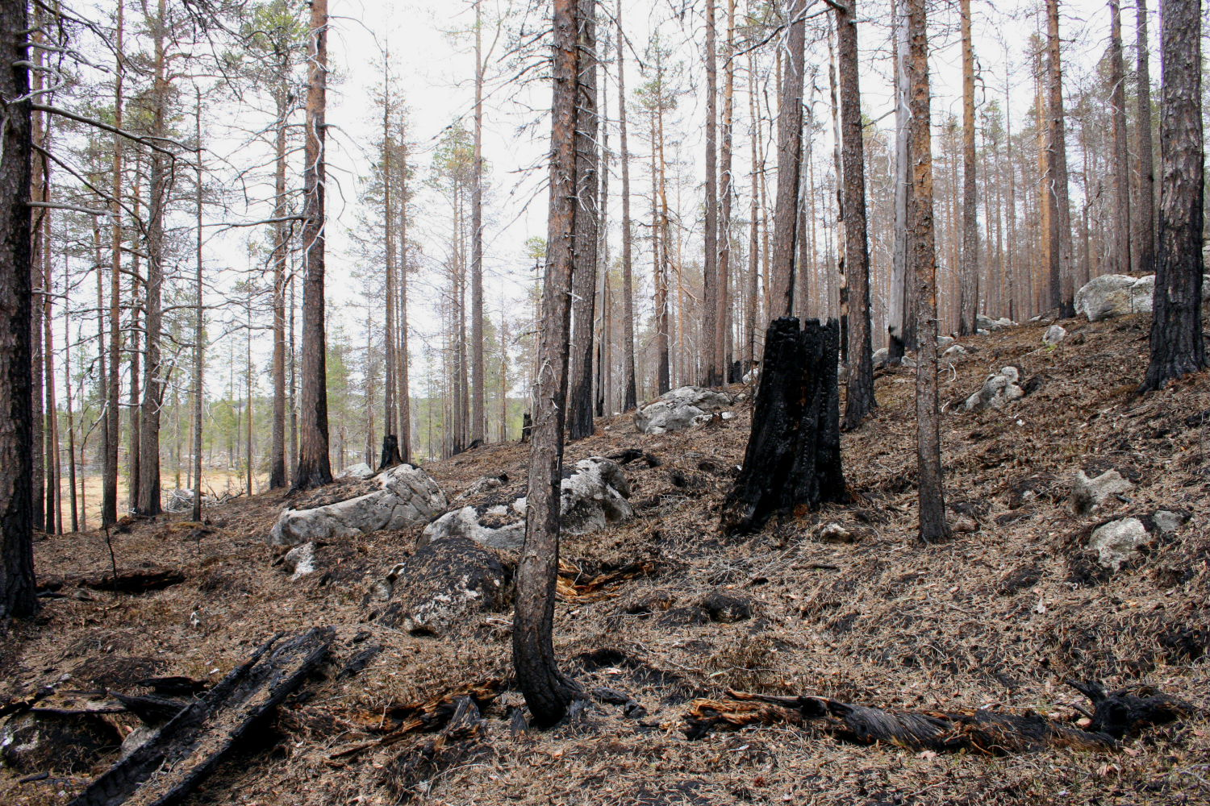
THANK YOU!
(restoration fire in the Nature Reserve
Jämtgaveln, central Sweden)
…why not allow ourselves to manage for biodiversity?

