Slide 1

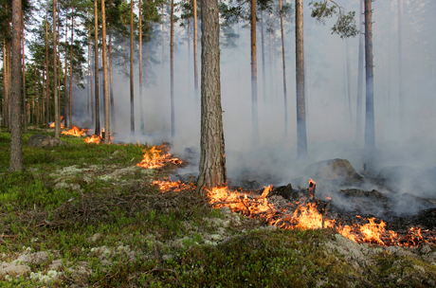
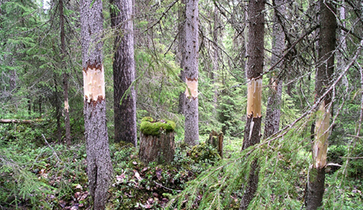
Mistra Council for Evidence-based
Environmental Management
What is the impact of active management on biodiversity in boreal and temperate forests set aside for conservation or restoration? A systematic map
Jennie Sandström, Bengt Gunnar Jonsson, Claes Bernes, Kaisa Junninen,
Jörg Müller, Asko Lõhmus, Ellen Macdonald
Photo: Trons/TT bild
Photo: Göran Eriksson, lst Jämtland

Slide 2

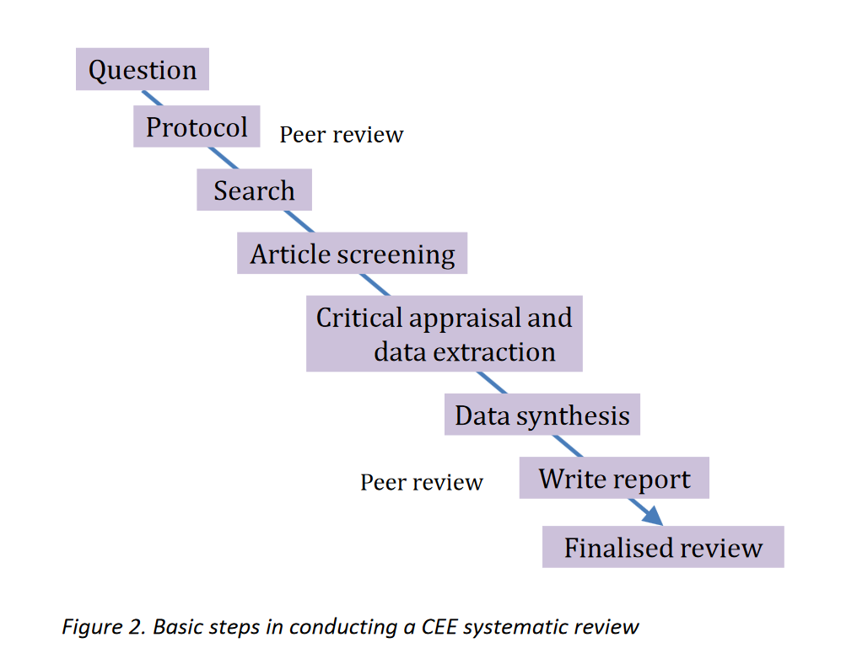
Mistra Council for Evidence-based
Environmental Management
Medical/health science has a lot of experience of evidence synthesis methodology
Systematic review
- Synthesise result
but do not give advice
Planning
Lit. ass.

Slide 3
Mistra Council for Evidence-based
Environmental Management
Systematic map – gives an overview of the evidence base
but do not synthesise results
Often a first step in a SR
Provide a database with description of
included articles
Planning
Lit. ass.
Not in a map.
Descr. of studies

Slide 4
Mistra Council for Evidence-based
Environmental Management
“What is the impact of active management on biodiversity in boreal and temperate forests set aside for conservation or restoration?”
Bernes C., Jonsson B-G., Junninen K., Lõhmus A., Macdonald A., Müller J. and Sandström J. (2015) What is the impact of active management on biodiversity in boreal and temperate forests set aside for conservation or restoration? A systematic map. Environmental Evidence, 4: 25, DOI 10.1186/s13750-015-0050-7.
Population/subject: Boreal and temperate forests set aside for conservation
or restoration of biodiversity
Intervention: Active management (e.g. partial harvesting,
thinning, prescribed burning, creation or addition of dead wood,
grazing or exclusion from grazing, and introduction or removal
of species)
Comparator: Non-intervention or alternative types of intervention
Outcomes: Measures or indicators of biodiversity

Slide 5
Mistra Council for Evidence-based
Environmental Management
Screening of articles using inclusion criteria:
Subjects | Forests in the boreal or temperate vegetation zones
Type of comparator | Non-intervention or alternative types of intervention
Types of intervention | Prescribed burning, Thinning, Partial harvesting, Removal of woody understorey or ground-layer vegetation, Removal or addition of litter or humus, Creation of dead wood, Addition (translocation) of dead wood, Exclusion or other deliberate manipulation of wild cervids and similar grazers/browsers, Livestock grazing and traditional mowing, coppicing and pollarding, Underplanting of trees and (re)introduction of native non-tree species, Control of exotic and/or invasive species, Hydrological restoration, Liming and use of herbicides, if the primary goal was conservation
Types of outcome

Slide 6
Mistra Council for Evidence-based
Environmental Management
Screening of articles using inclusion criteria:
Subjects | Forests in the boreal or temperate vegetation zones
Type of comparator | Non-intervention or alternative types of intervention
Types of intervention | Prescribed burning, Thinning, Partial harvesting, Removal of woody understorey or ground-layer vegetation, Removal or addition of litter or humus, Creation of dead wood, Addition (translocation) of dead wood, Exclusion or other deliberate manipulation of wild cervids and similar grazers/browsers, Livestock grazing and traditional mowing, coppicing and pollarding, Underplanting of trees and (re)introduction of native non-tree species, Control of exotic and/or invasive species, Hydrological restoration, Liming and use of herbicides, if the primary goal was conservation
Types of outcome
Not wildfires!

Slide 7
Mistra Council for Evidence-based
Environmental Management
Screening of articles using inclusion criteria:
Subjects | Forests in the boreal or temperate vegetation zones
Type of comparator | Non-intervention or alternative types of intervention
Types of intervention | Prescribed burning, Thinning, Partial harvesting, Removal of woody understorey or ground-layer vegetation, Removal or addition of litter or humus, Creation of dead wood, Addition (translocation) of dead wood, Exclusion or other deliberate manipulation of wild cervids and similar grazers/browsers, Livestock grazing and traditional mowing, coppicing and pollarding, Underplanting of trees and (re)introduction of native non-tree species, Control of exotic and/or invasive species, Hydrological restoration, Liming and use of herbicides, if the primary goal was conservation
Types of outcome | Abundance of single species or taxonomic or functional groups of terrestrial organisms (including the soil seed bank), Species richness, diversity index and composition of taxonomic or functional groups of terrestrial organisms (including the soil seed bank), Performance and population viability of target species, Tree mortality, Abundance and diversity of dead wood, Stand structure (horizontal and/or vertical distribution of trees), Occurrence of tree microhabitats (e.g. cavities)

Slide 8
Mistra Council for Evidence-based
Environmental Management
Screening
of articles:

Slide 9
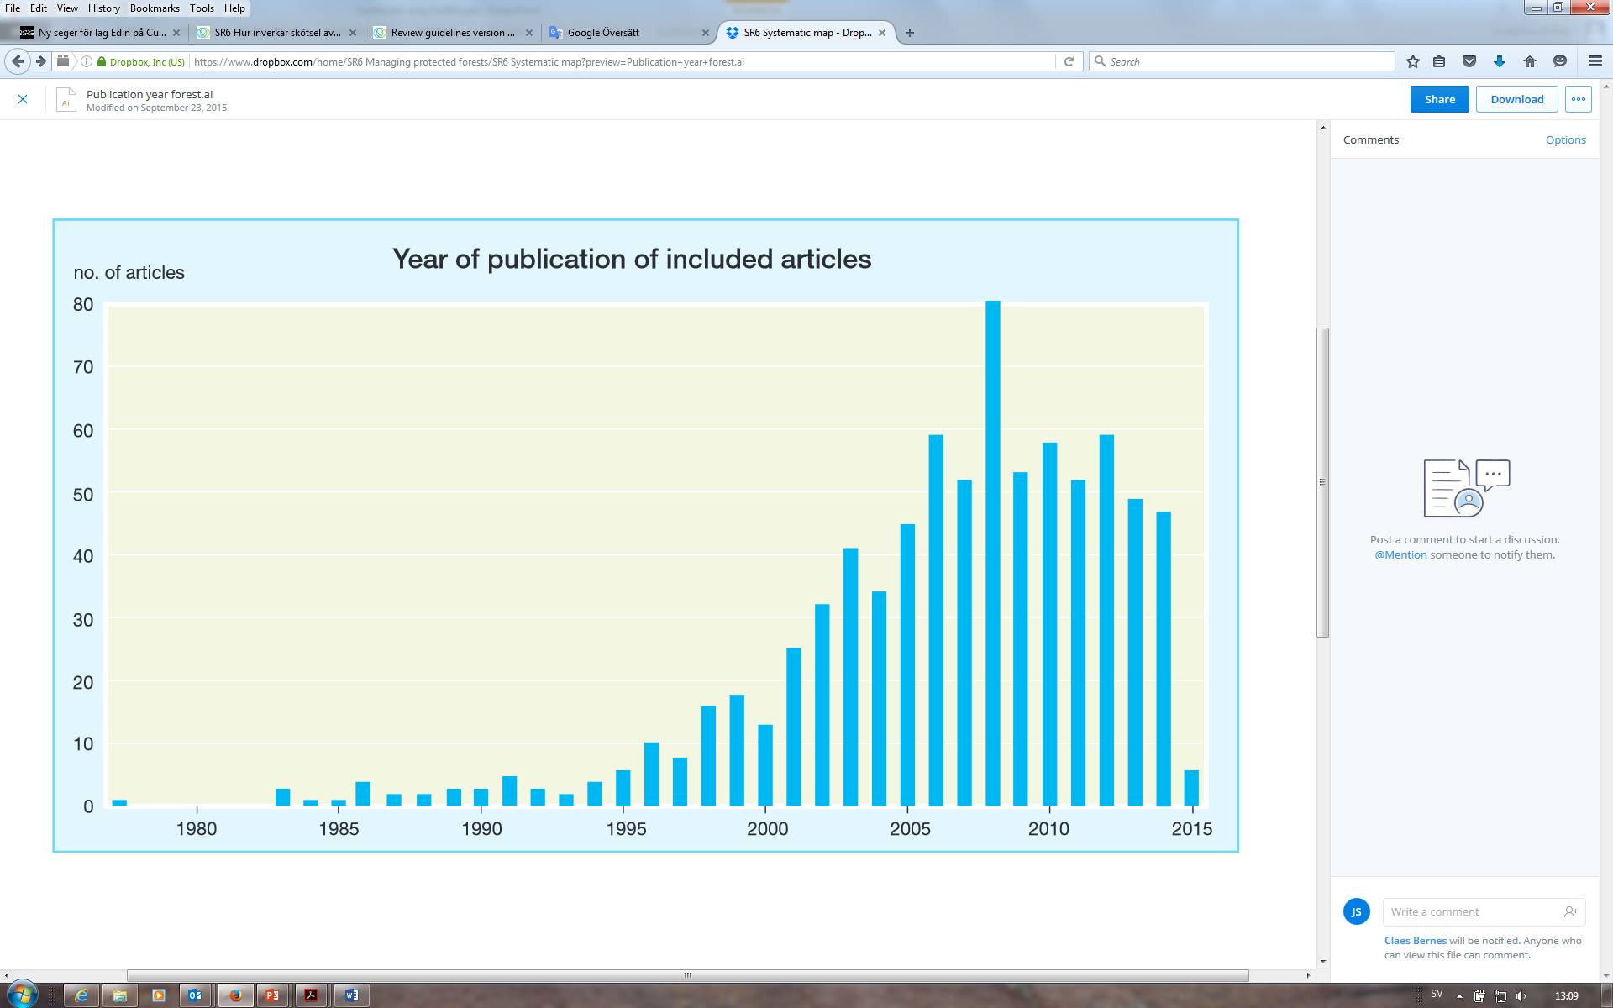
Mistra Council for Evidence-based
Environmental Management
Most studies have been published since 2000

Slide 10
Mistra Council for Evidence-based
Environmental Management
Location of included studies:

Slide 11
Mistra Council for Evidence-based
Environmental Management

Slide 12
Mistra Council for Evidence-based
Environmental Management
Number of included studies, different interventions
Number of included studies, different outcomes
Partial harvesting
Thinning
Burning
Grazing (+ exclusion)
Creation of dead wood
Addition of dead wood
Removal of woody understorey
Underplanting
Control of invasive species
Litter manipulation
Removal of ground vegetation
Mowing
Coppicing
Pollarding
Introduction of non-tree species
Hydrological interventions
Other interventions
311
311
229
227
157
66
19
57
25
21
20
9
10
4
4
11
4
13
Trees
Vascular plants (other than tree)
Dead wood
Birds
Vertical structure
Bryophytes
Saproxylic beetles
Mammals
Invasive species
Lichens
Fungi
Amphibians
Reptiles
Ground beetles
Other beetles
Insects (not beetles)
Arthropods (not insects)
Invertebrates (not arthr)
Microhabitats (tree)
Horizontal structure
401
373
153
115
115
88
78
71
69
56
52
17
6
54
36
75
64
13
18
5

Slide 13
Mistra Council for Evidence-based
Environmental Management
Combinations of common interventions and outcomes
 | Vertical structure | Dead wood | Vascular plants | Birds | Saproxylic beetles | Ground beetles | Insects | Invasive species
Burning | 34 | 60 | 105 | 31 | 34 | 16 | 10 | 30
Thinning | 57 | 55 | 113 | 34 | 19 | 10 | 16 | 22
Partial harvest | 48 | 73 | 113 | 49 | 29 | 25 | 38 | 15
Removal understorey | 7 | 7 | 27 | 7 | 4 | 3 | 5 | 9
Creation of dead wood | 2 | 16 | 9 | 6 | 31 | 1 | 6 | 0
Addition of dead wood | 0 | 3 | 1 | 0 | 11 | 1 | 3 | 0
Grazing | 18 | 8 | 110 | 13 | 2 | 15 | 18 | 15

Slide 14
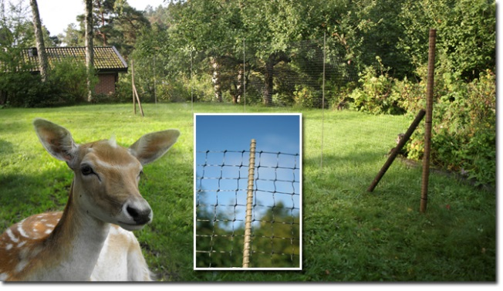
Mistra Council for Evidence-based
Environmental Management
2 systematic reviews
(will include critical appraisal and meta-analysis):
” What are the impacts of dead-wood manipulation
on the biodiversity of temperate and boreal forests?”
“What are the impacts of manipulating grazing
and browsing by ungulates on plants and invertebrates
in temperate and boreal forests?”

Slide 15
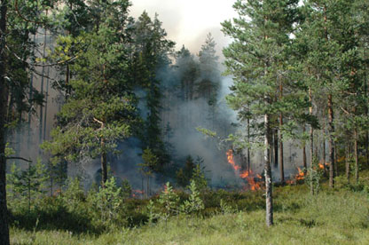
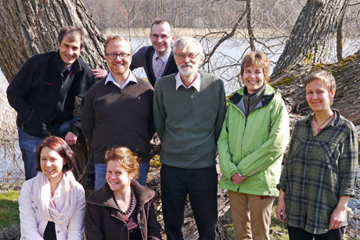
Mistra Council for Evidence-based
Environmental Management
Thank you!

Slide 16
Mistra Council for Evidence-based
Environmental Management

